Slide 1
FEEDBACK SYSTEM FOR ONLINE FOOD
REVIEW -01 MINI PROJECT

Slide 2
TEAM MEMBERS
Huzaifa Shariff
Sugunashree MK
-20211IST0003
-20211IST0002

Slide 3
01.
Review -0
3oth March 2024
Timeline of Project
02.
Review -01
15th May 2024

Slide 4

Introduction
A feedback system is like having a direct line of communication with your customers. It allows them to share their thoughts, opinions, and experiences with the food they've tried.
This feedback can range from simple ratings to detailed reviews, giving you valuable insights into what's working well and what might need improvement.

Slide 5
Defining Key Metrics and KPIs
Customer Satisfaction Score (CSAT).
Order Accuracy Rate.
Delivery Time.
Product Popularity.
Customer Retention Rate.
Net Promoter Score (NPS).

Slide 6

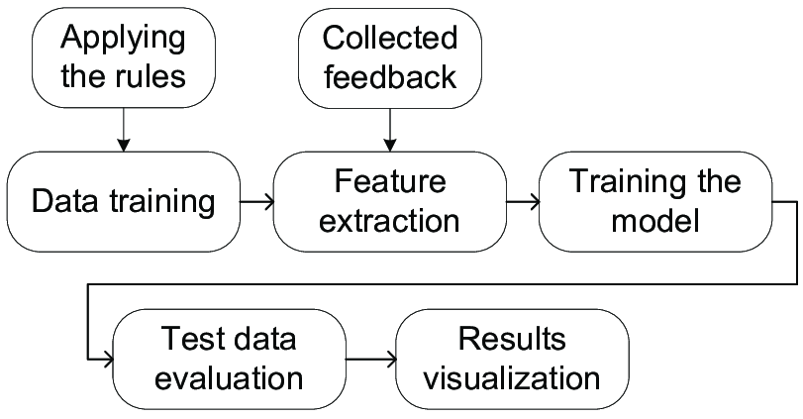

Methodology
Identify Key Metrics
Feedback Channels.
Timeliness.
User-Friendly Interface..
Incentives
Analyze Data
Continuous Improvement
Privacy and Security

Slide 7
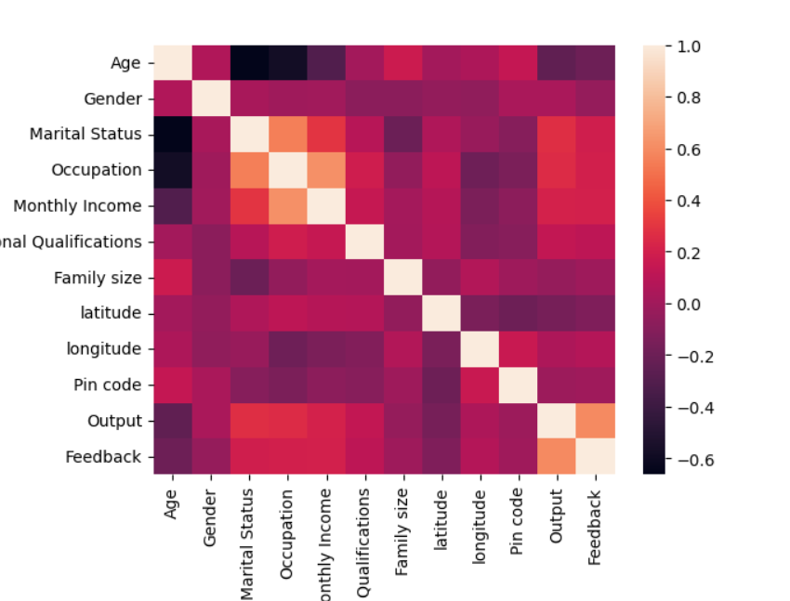
Correlation
This code snippet creates a heatmap visualization of a confusion matrix using seaborn and matplotlib libraries. The confusion matrix compares the actual labels (yTrue) with the predicted labels (yPred) generated by a classification model.

Slide 8
Importance of Customer Feedback
Insight into Customer Preferences.
Identifying Areas for Improvement.
Enhancing Customer Satisfaction.
Building Trust and Loyalty.
Staying Competitive.
Driving Innovation.

Slide 9
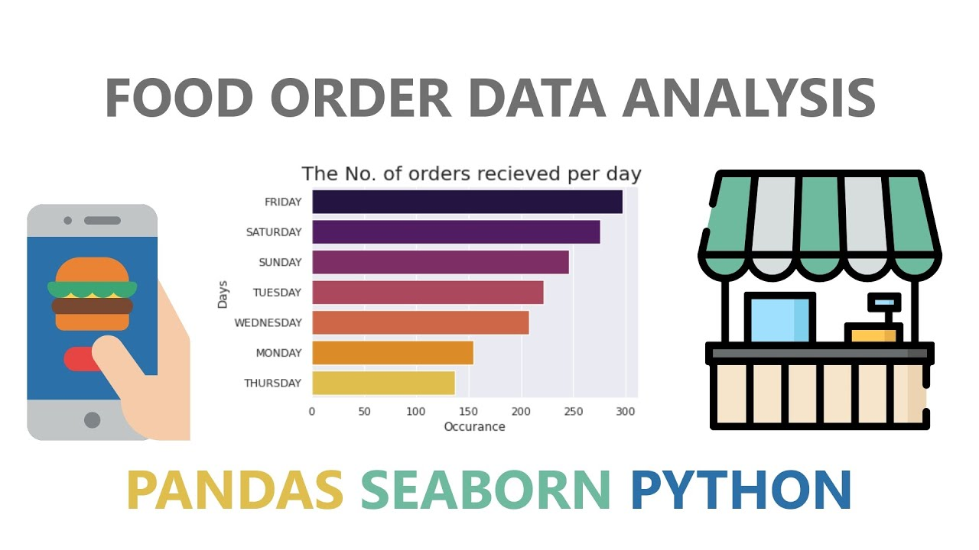
Implementation
Importing the dataset
Dataset Selection
Data Preprocessing
Feedback Collection.
Data Integration
Model Development.
.

Slide 10
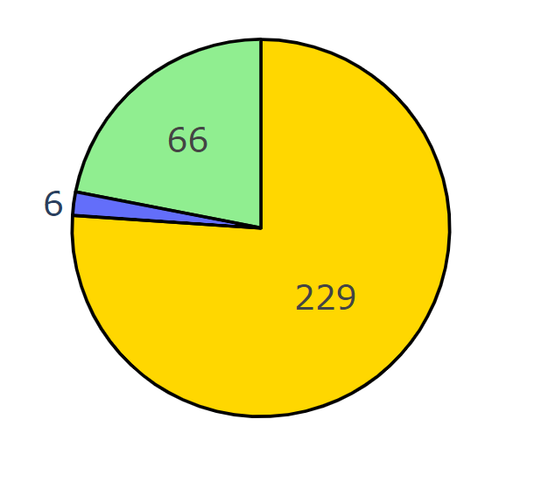
Result Outcomes
This code creates a visually appealing pie chart using Plotly to show the distribution of different income groups that order food online, with customized colors, hover information, and text styling.
Pie Chart

Slide 11

Conclusion
In conclusion, building a feedback system for our online food service using the Kaggle dataset has been a rewarding endeavor. Through this project, we've gained valuable insights into customer preferences, satisfaction levels, and areas for improvement.

Slide 12
THANK YOU VERY MUCH!

